Slide 1
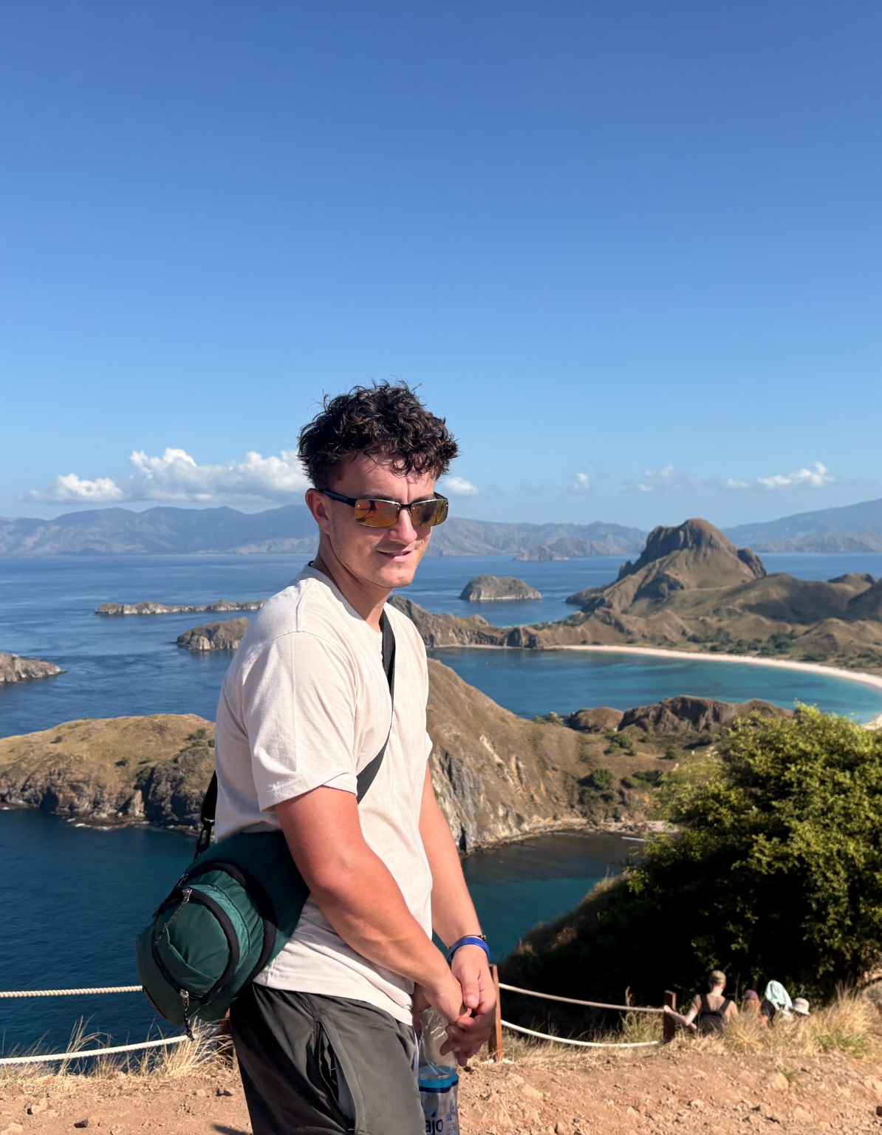
01
MEDIA KIT 2026
SOLO TRAVEL
TYPE 1 DIABETES
SEVERE ALLERGIES
OLLIE
STEADMAN
Honest solo-travel stories shaped by Type 1 diabetes and severe allergies.
Candid journeys, practical problem-solving and a point of view audiences trust.
6.66M Instagram views • 90 days • 11 Apr–9 Jul
ollietype1travel@outlook.com

Slide 2
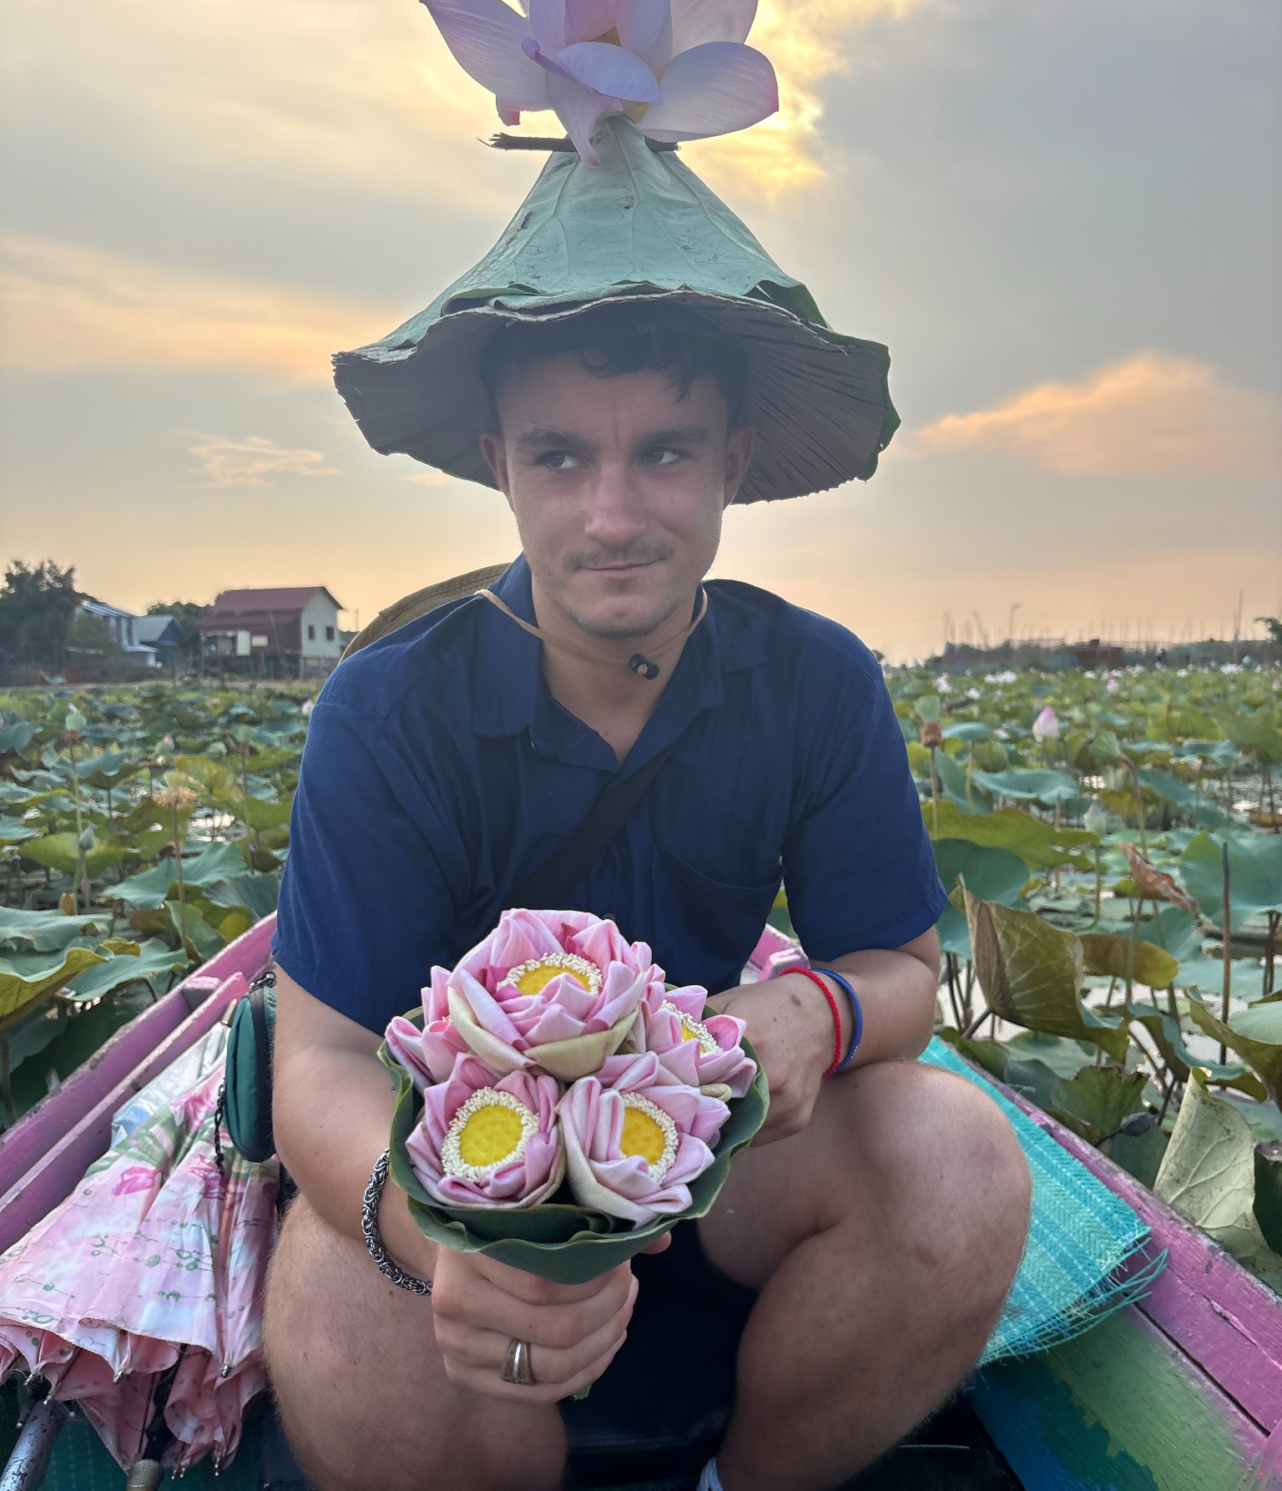
02
ABOUT OLLIE
REAL TRAVEL.
USEFUL STORIES.
I share the real decisions behind solo travel with Type 1 diabetes and severe allergies — the mishaps, problem-solving, people and freedom.
LIVED EXPERIENCE
Products and places appear in the moments where I genuinely rely on them.
PRACTICAL VALUE
Useful detail on safety, routines and the decisions that make a journey possible.
STORY-LED EXECUTION
Hook-led vertical video built around tension, humour and practical problem-solving.
PURPOSE-LED PERSPECTIVE
Diabetes UK Young Leader and Action4Diabetes volunteer.
MY POINT OF VIEW
Honest moments. Useful detail.
A credible role for the right brand.
NATURAL BRAND FIT
Destinations, stays, tours, travel tech, insurance and accessibility-led products.
Solo travel • health and accessibility • practical adventure
ollietype1travel@outlook.com
Instagram @type1solotravel • TikTok @type1solotravel

Slide 3
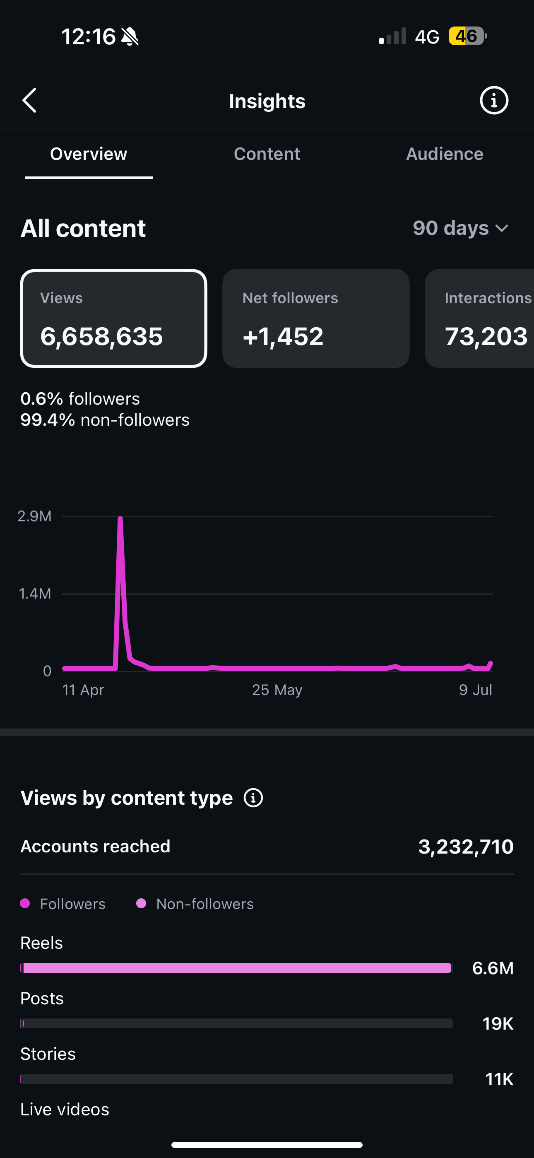
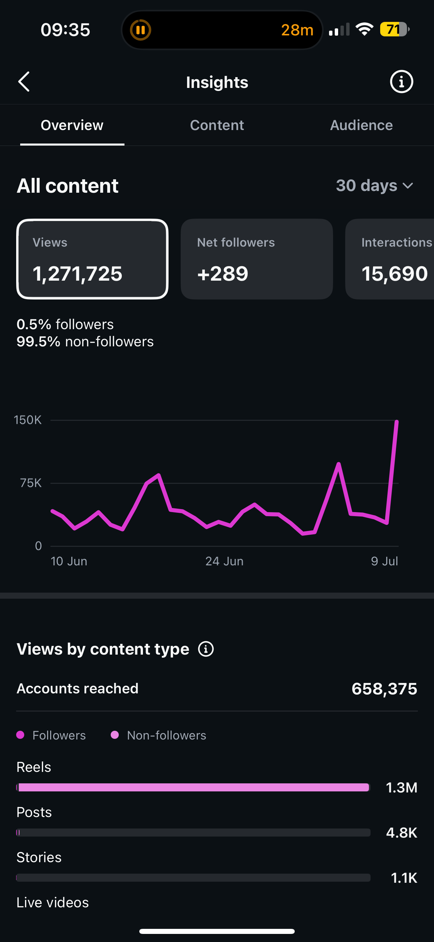
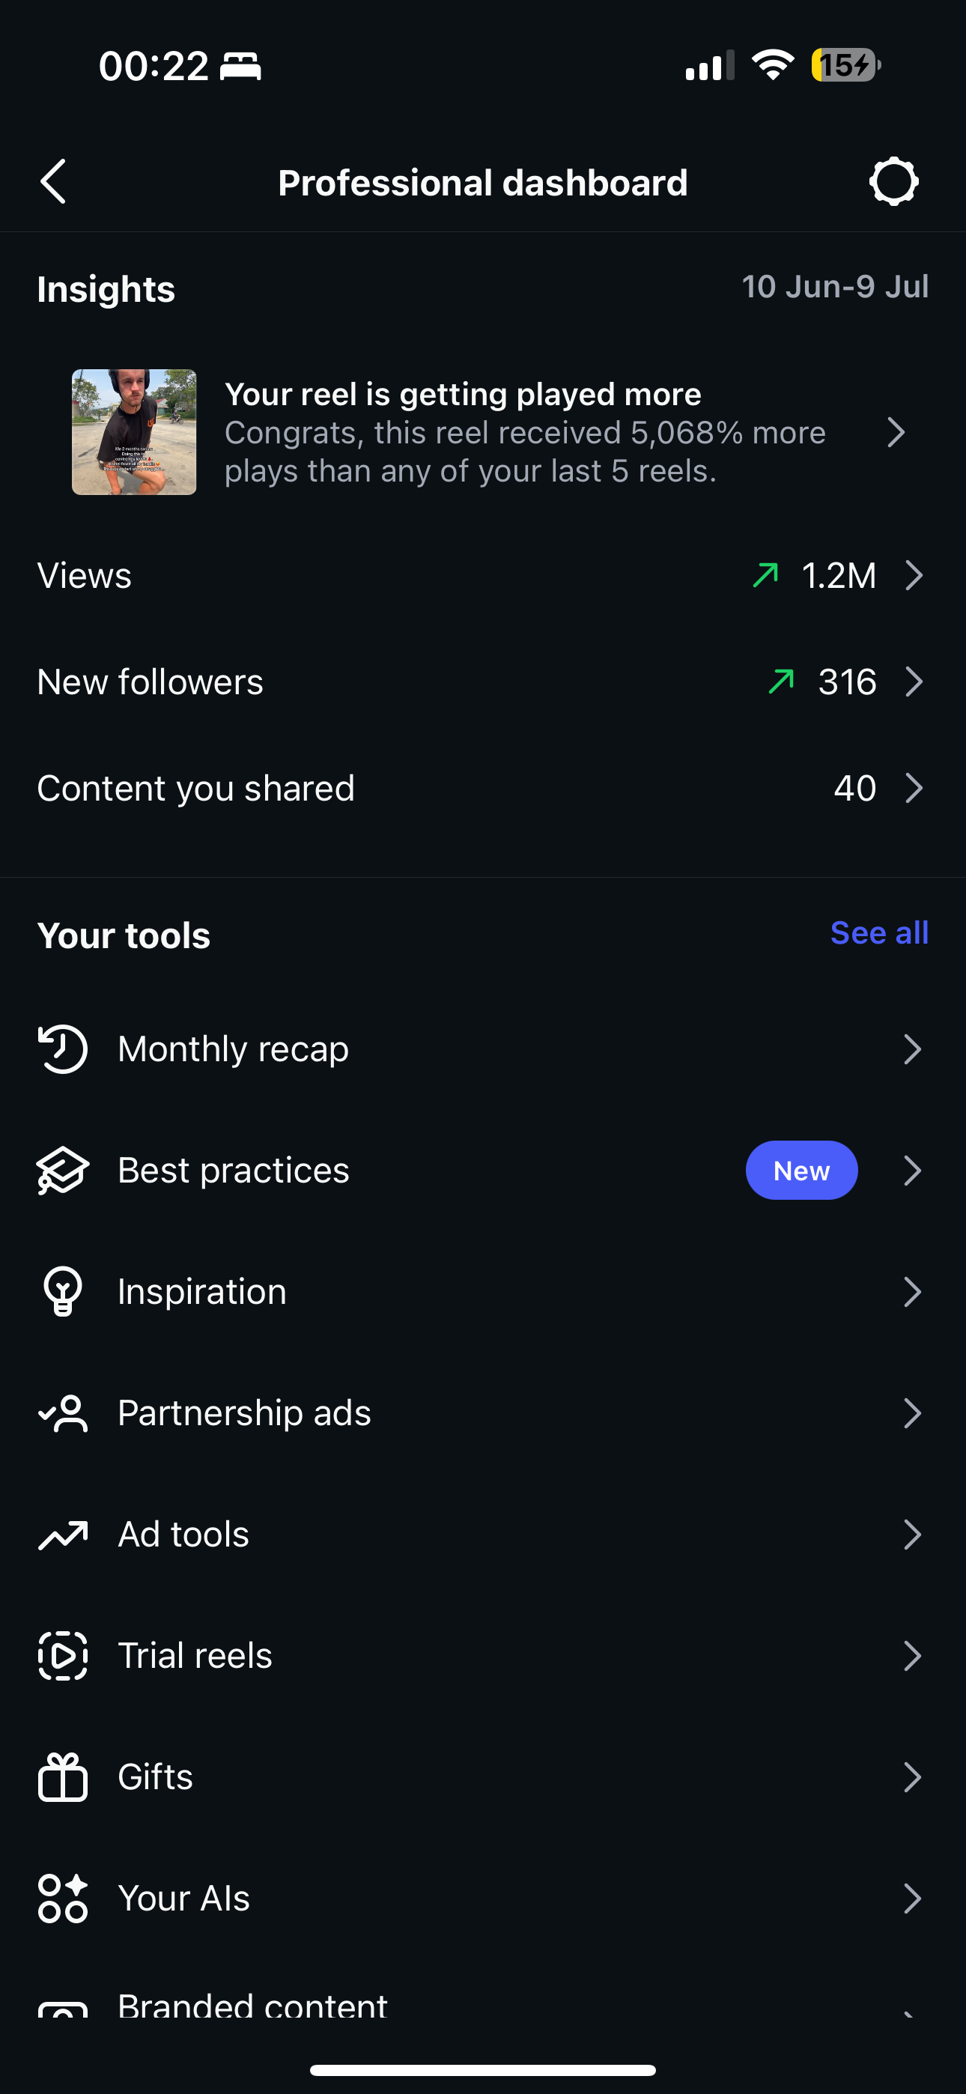
03
VERIFIED REACH
THE CONTENT TRAVELS
BEYOND MY AUDIENCE.
Instagram Insights show strong discovery across both 90-day and recent 30-day windows.
90-DAY SCALE
DISCOVERY
RECENT MOMENTUM
6.66M views reached 3.23M Instagram accounts.
99.4% of 90-day views came from non-followers.
1.27M views and 658K accounts reached in 30 days.
6,658,635
3,232,710
73,203
99.4%
Instagram views · 90d
IG accounts reached · 90d
IG interactions · 90d
non-follower views · 90d
Instagram Insights • 90 days: 11 Apr–9 Jul • 30 days: 10 Jun–9 Jul
90-DAY • 30-DAY • DASHBOARD
Discovery gives brands scale: almost every view came from outside the existing audience.

Slide 4
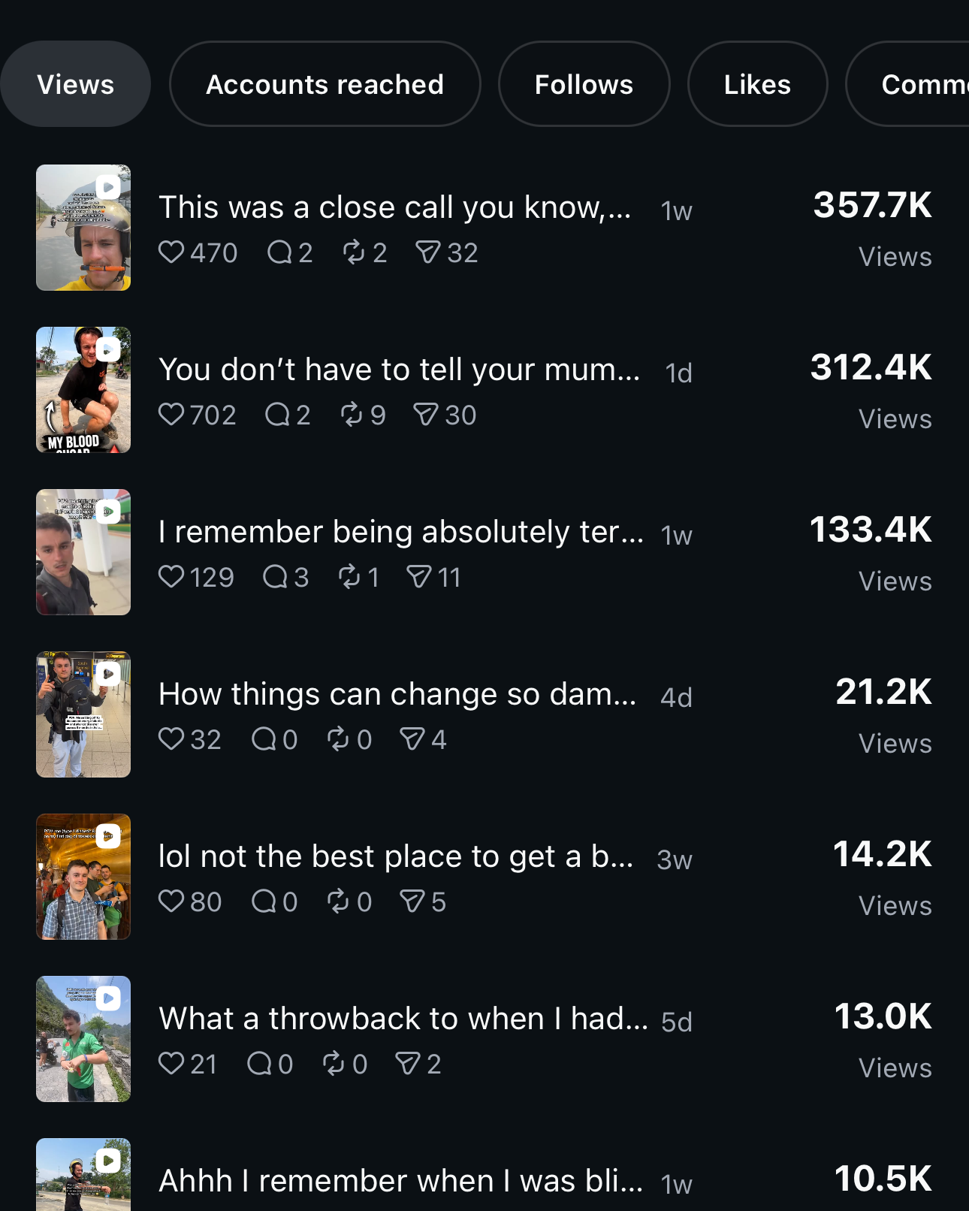
04
RECENT CONTENT
THREE REELS.
133K+ VIEWS EACH.
The 30-day content view shows three recent Reels passing 133K views, with two above 300K.
357.7K VIEWS
Top Reel • Instagram • 30-day content view
312.4K VIEWS
Second Reel • Instagram • 30-day content view
133.4K VIEWS
Third Reel • Instagram • 30-day content view
1,271,725 VIEWS
All Instagram content • 30 days • 10 Jun–9 Jul
PLATFORM SIGNAL
One Reel received 5,068% more plays
than any of the previous five Reels.
99.5% NON-FOLLOWERS
Share of Instagram views • same 30-day period
Instagram Reels • 30-day content view
Source: Instagram Insights
Dashboard: 10 Jun–9 Jul

Slide 5
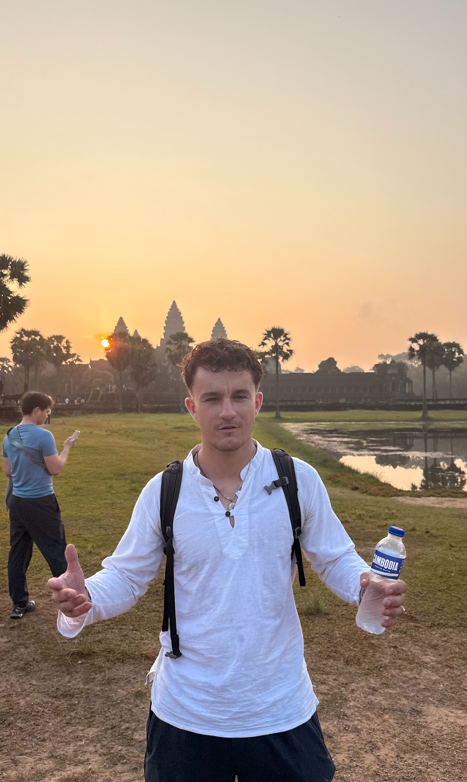
05
PARTNERSHIPS
BUILD THE BRAND INTO
A JOURNEY PEOPLE FOLLOW.
Every partnership starts with a real travel need, decision or challenge — then becomes a hook-led story that shows the brand in use.
HOSTED STAYS + DESTINATIONS
Authentic hotel, hostel and destination stories built around the experience.
TOURS + EXPERIENCES
Bring viewers into the activity with a clear reason to care.
TRAVEL TECH + SAFETY
eSIMs, apps, insurance and safety products shown on a real journey.
UGC + PAID SOCIAL
Hook-led vertical creative for organic and paid channels.
OPEN TO
Paid partnerships • hosted travel
UGC licensing • destination campaigns
RIGHTS + REPORTING
Usage by agreement, with a clear analytics recap after delivery.
Concept • hooks • filming • editing • organic posting • analytics recap
ollietype1travel@outlook.com
Instagram @type1solotravel • TikTok @type1solotravel

